Slide 1
Systems Analysis and Design 10th Edition
ToolKit B– The Systems Analyst’s Toolkit – CASE Tools

Slide 2
Chapter Objectives
Explain CASE tools and the concept of a CASE environment
Trace the history of CASE tools and their role in a fourth-generation environment
Define CASE terms and concepts, including a repository, modeling tools, documentation tools, engineering tools, and construction tools
Explain an integrated development environment (IDE) and application life cycle management (ALM) solutions
Provide examples of CASE tool features
Describe CASE tool trends, and how they relate to object-oriented analysis and agile methods

Slide 3
Overview of CASE Tools
Every type of work requires specific tools to do the job properly
Carpenters use hammers, drills, or screwdrivers
Chefs measuring cups, knives, or spatulas
System development is no different
CASE tools can reduce costs, speed up development, and provide comprehensive documentation for future maintenance or enhancements

Slide 4
Overview of CASE Tools (Cont.)
CASE Tools History
In the past, programmers used tools such as editors and code debuggers to write mainframe computer applications in procedural programming languages such as COBOL
Fourth-generation language environments include modern CASE tools so system developers can deliver high quality software, shorten the timetable, and reduce expense

Slide 5
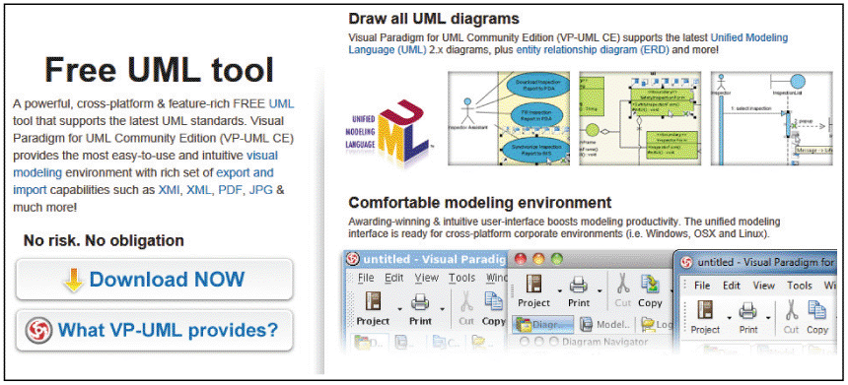
Overview of CASE Tools (Cont.)
The Marketplace for CASE Tools
There is a wide variety of vendors and products, and no one tool dominates the market
Selecting a CASE tool involves deciding on the type of project, its size and scope, possible budgetary and time constraints, and the preferences and experience of the system development team
FIGURE TK B-3 This site offers many free downloads, such as the UML modeling tool shown here

Slide 6
CASE Terms and Concepts
Repository
A repository is a database that serves as a central storage location for all information about the system being developed
Once a data element has been defined in the repository, it can be accessed and used by processes and other information systems

Slide 7
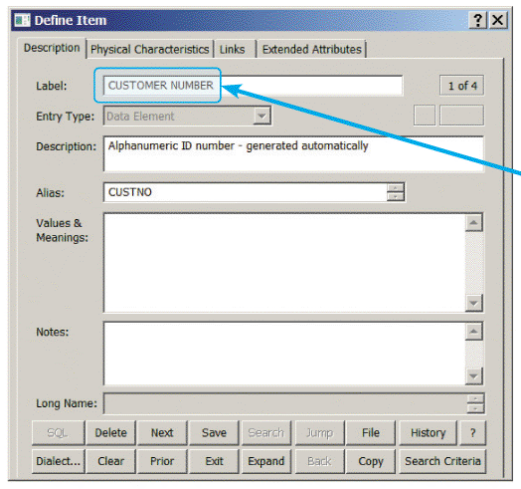
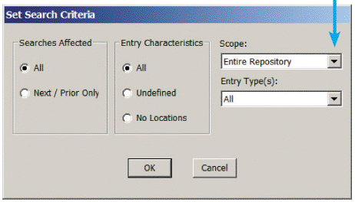
CASE Terms and Concepts (Cont.)
FIGURE TK B-5 A Visible Analyst repository search for the data element named
CUSTOMER NUMBER. The results will show all instances of the data element

Slide 8
CASE Terms and Concepts (Cont.)
Individual Tools
Can be used to model, document, engineer, and construct the information system
MODELING TOOLS
Unified Modeling Language diagrams and functional decomposition diagrams (Chapter 4)
Data flow diagrams (Chapter 5)
Object diagrams (Chapter 6)
Entity-relationship diagrams (Chapter 9)
Structure charts (Chapter 10)

Slide 9
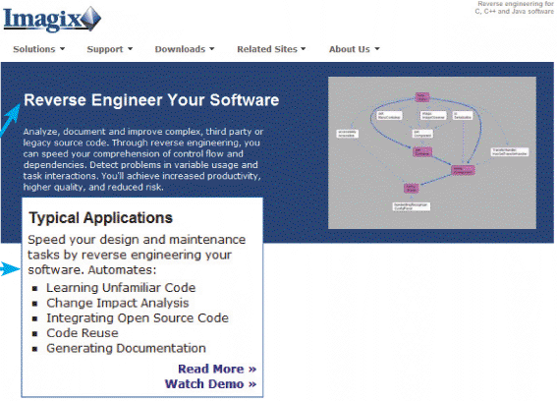
CASE Terms and Concepts (Cont.)
DOCUMENTATION TOOLS
Main source of system documentation is the Repository
Many CASE products provide tools that check automatically for inconsistent or incomplete information in forms, reports, and diagrams
ENGINEERING TOOLS
Forward engineering translates business processes into applications
Reverse engineering takes an existing application and breaks it down into diagrams, structure charts, and source code
FIGURE TK B-6 Imagix claims that its reverse engineering tool can automate many expensive, time-consuming tasks

Slide 10
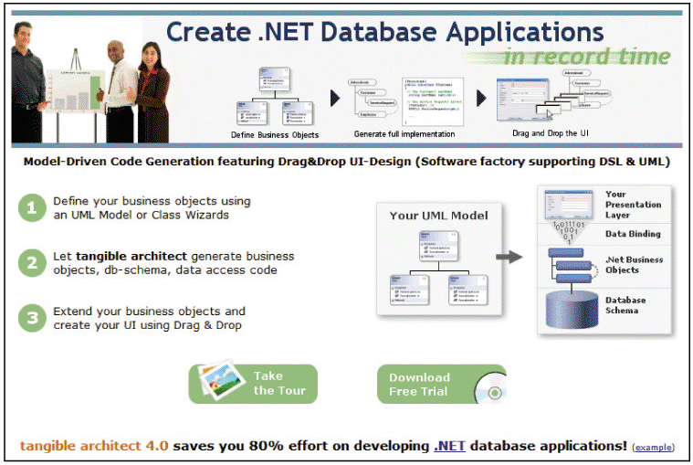
CASE Terms and Concepts (Cont.)
CONSTRUCTION TOOLS
An application generator, also called a code generator, allows you to develop computer programs rapidly by translating a logical model directly into code
FIGURE TK B-7 Tangible Architect includes a code generator that can create .NET database applications

Slide 11
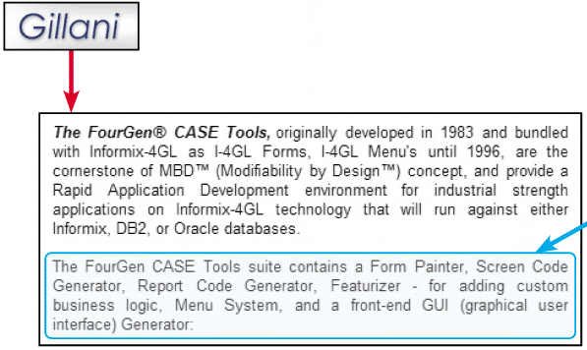
CASE Terms and Concepts (Cont.)
CONSTRUCTION TOOLS (Cont.)
A screen generator, or form painter, is an interactive tool that helps you design a custom interface, create screen forms, and handle data entry format and procedures
FIGURE TK B-8 Gillani’s FourGen® CASE tools include a form painter and a screen code generator

Slide 12
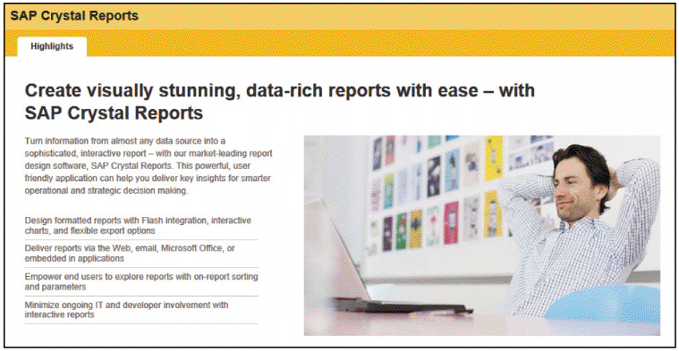
CASE Terms and Concepts (Cont.)
CONSTRUCTION TOOLS (Cont.)
A report generator, also called a report writer, is a tool for designing formatted reports rapidly
FIGURE TK B-9 SAP Crystal Reports is a popular report generator that can display business analytics and support decision-making

Slide 13
Development Environments
Integrated Development Environments
(IDE) uses built-in tools provided by the software vendor that make it easier to create applications based on their products
Application Life Cycle Management Environment
(ALM) refers to a start-to-finish approach to planning, designing, developing, deploying, managing, and maintaining an information system
ALM tools and processes can help an organization speed up systems development and reduce costs

Slide 14
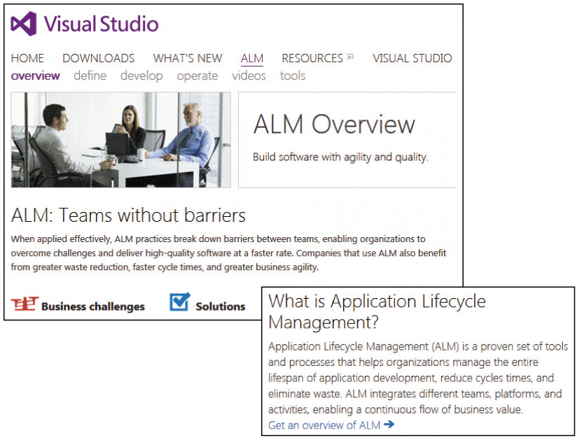
Development Environments (Cont.)
FIGURE TK B-10 Microsoft’s Visual Studio 2012 stresses the benefits of ALM

Slide 15
Development Environments (Cont.)
Pros and Cons of Integrated Development Tools
In a specific software environment, an integrated development tool is highly effective because it is built into the vendor’s software package
The only possible disadvantage is that each IDE is different, and requires a learning curve and skills that might or might not be readily transferable
In contrast, non-specific CASE tools such as Visible Analyst or Rational System Architect can be used in any development environment

Slide 16
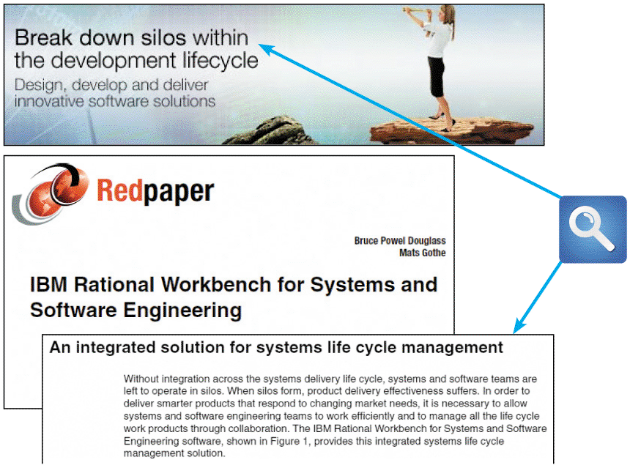
Development Environments (Cont.)
FIGURE TK B-11 Note IBM’s reference to silos, and the emphasis on life cycle management

Slide 17
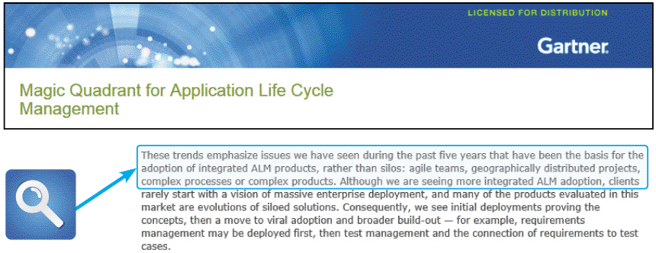
Development Environments (Cont.)
FIGURE TK B-12 Gartner views ALM as an emerging market, driven by new technology and corporate pressure for cost reduction

Slide 18
CASE Tool Examples
Visible Analyst
The Visible Analyst® CASE tool can generate many types of models and diagrams including an entity-relationship diagram and a data flow diagram
Rational Software
IBM offers many systems development and modeling products, including a powerful tool called Rational System Architect
IBM claims that the product stresses modeling and collaboration, and is a suite of tools that can align processes, information, and technologies

Slide 19
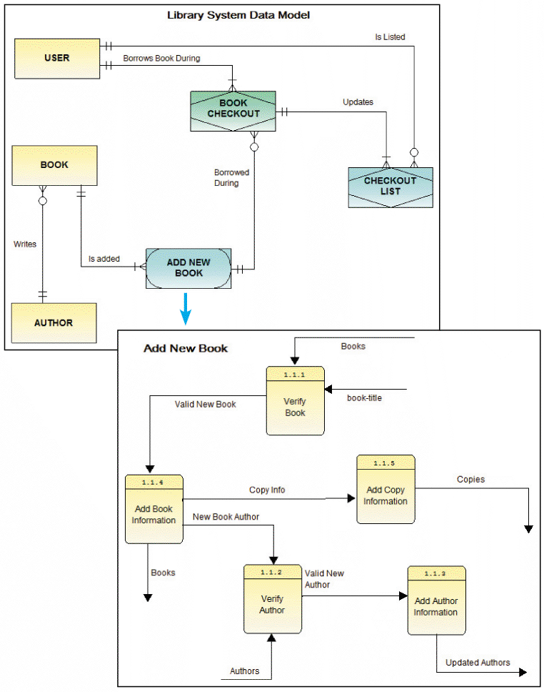
CASE Tool Examples (Cont.)
FIGURE TK B-13 These Visible Analyst diagrams integrate with a central data repository for the Library System

Slide 20
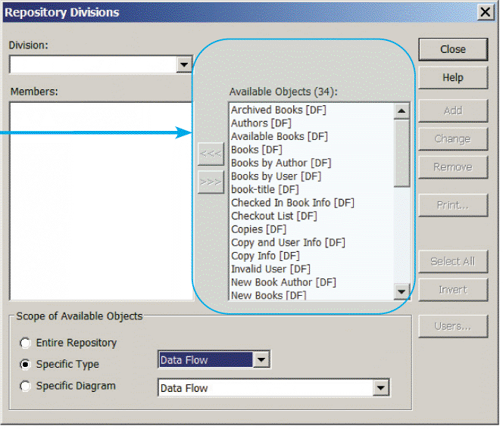
CASE Tool Examples (Cont.)
FIGURE TK B-14 The repository for the Library System stores the objects that appear in models, diagrams, and definitions

Slide 21
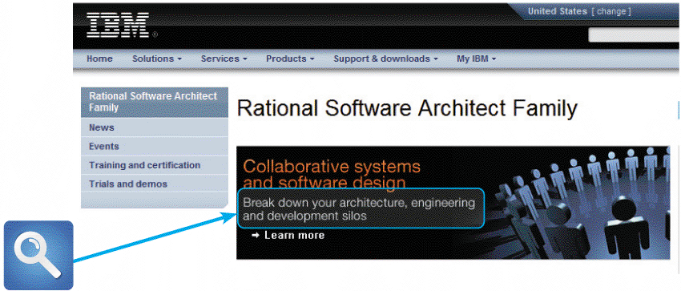
CASE Tool Examples (Cont.)
FIGURE TK B-15 IBM’s Rational Systems Architect stresses collaboration and integration. Note the use of the term “silos,” which was mentioned in the IBM Redpaper shown in Figure TK B-11 on page 591

Slide 22
CASE Tool Trends
New Products and Features
CASE tool vendors constantly offer more features and greater flexibility
Examples include a framework to help transform business processes into an information system
Zachman Framework (shown on next slide) arranges traditional fact-finding questions into a useful matrix
The vertical axis shows five development stages and stakeholder roles
The horizontal axis displays six essential fact-finding questions

Slide 23
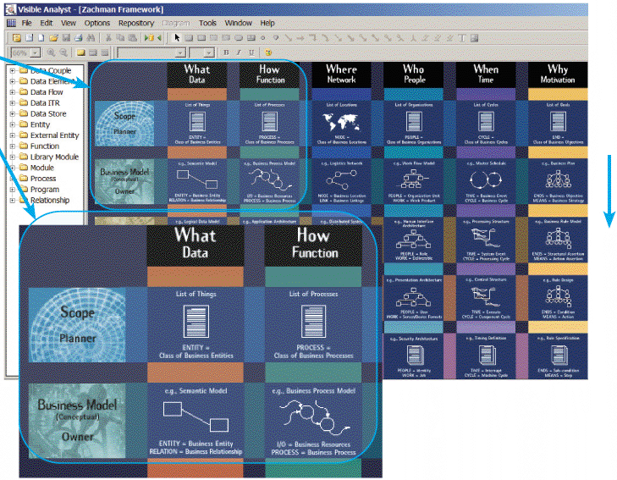
CASE Tool Trends (Cont.)
FIGURE TK B-16 The Zachman Framework provides an easy-to-follow matrix that helps system
developers work on specific areas, and then integrate the results into an overall model

Slide 24
CASE Tool Trends (Cont.)
Method-Specific CASE Tools
Structured development relies heavily on DFDs and structure charts
Traditional approach that is time-tested and easy to understand
Object-oriented methods use a variety of diagrams, such as use case, class, sequence, and transition state diagrams
object-oriented analysis and design (OOAD) is very popular
Agile methods tend to use spiral or other iterative models
Agile developers use a wide range of modeling tools, including CASE tools

Slide 25
Toolkit Summary
CASE stands for computer-aided systems engineering. CASE tools are software programs that system developers use to help them design and construct information systems
Older systems used program code that was written in procedural languages while modern languages are non-procedural
Non-procedural languages allow system developers to develop accurate prototypes, cut development time, and reduce expense

Slide 26
Chapter Summary (Cont.)
A repository is a database that serves as a central storage location for all information about the system being developed
An integrated set of CASE tools can be used to model, document, engineer, and construct the information system
The main source of system documentation is the repository, which identifies new elements and adds them to the database
Forward engineering means translating business processes and functions into applications

Slide 27
Chapter Summary (Cont.)
Reverse engineering allows you to examine an existing application and break it down into a series of diagrams, structure charts, and, in some cases, source code
A CASE tool can handle many program development tasks, such as generating application code, screens, and reports
An integrated development environment (IDE) uses a built-in CASE tool that a software vendor includes to make it easier to plan, construct, and maintain a specific software product

Slide 28
Chapter Summary (Cont.)
Many vendors, including IBM and Microsoft, are calling attention to application life cycle management (ALM) concepts and tools
Two trends seem clear
CASE tool vendors will continue to include powerful new features
The popularity of object-oriented tools will continue to grow

